Slide 1
Th17 GSEA
Using GSVA Package

Slide 2
Three Th17 Signatures
Th17 Standard:
From Jack’s work.
Signature of 30 genes.
Published by Castro et al 2017 (PLoS One).
Th17 Enhanced:
Additional genes from the above signature, 43 total.
Predominantly additional IL-17 related genes.
Th17 CodeSet:
Large published gene set covering Th17 differentiation and activation.
418 genes published by Hu et al 2017 (Nature Comms).
Comparing patients from TCGA Pancancer atlas with KRAS, STK11 and double MTs in one group vs patients without MTs in these genes in the second group.

Slide 3
Standard and Enhanced Th17 Signatures
ABCA1 | ADAM12 | NLF1 | NLF2
CCL20 | CCR6 | COL5A1 | COL5A3
CTSH | GNLY | IL17A | IL17F
IL22 | IL26 | IQCG | MATN2
NOL3 | PKHD1 | PPARG | C6ORF145
RAPGEF3 | RORC | C1ORF113 | TIMP1
RORA | IL23R | IL23A | APH1A
ZBTB16 | IL17B | IL17C | IL17D
IL17F | IL17RA | IL17RB | IL17RC
IL17RD | IL17RE | IL17REL | IL12B
IL6R | IL6 | STAT3
Standard + Enhanced Signatures
Enhanced Signature Only

Slide 4
Three GSEA Methods
Default GSVA method.
PLAGE method.
SSGSEA method.
PLAGE and SSGSEA reported as good GSEA methods.
See Tarca et al 2013 PLoS One paper for methods comparison, based on sensitivity, prioritisation and specificity.

Slide 5
Two Ways of Running GSEA
Method 1 Pre-GSEA Sorting
Split data into
comparisons e.g. WT vs MT
Prep data
GSEA
Analysis
OR
Method 2 Post-GSEA Sorting
Split data into
comparisons e.g. WT vs MT
Analysis
Prep data
GSEA

Slide 6
Method 1 Pre-GSEA Sorting

Slide 7
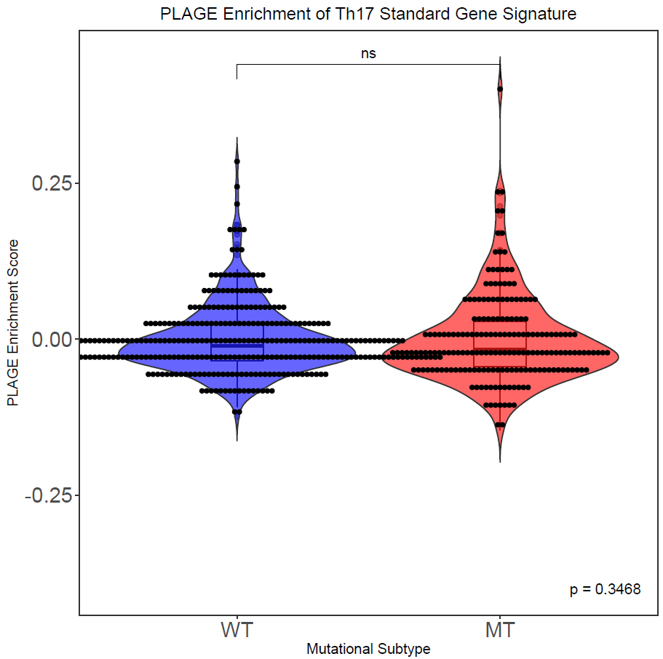
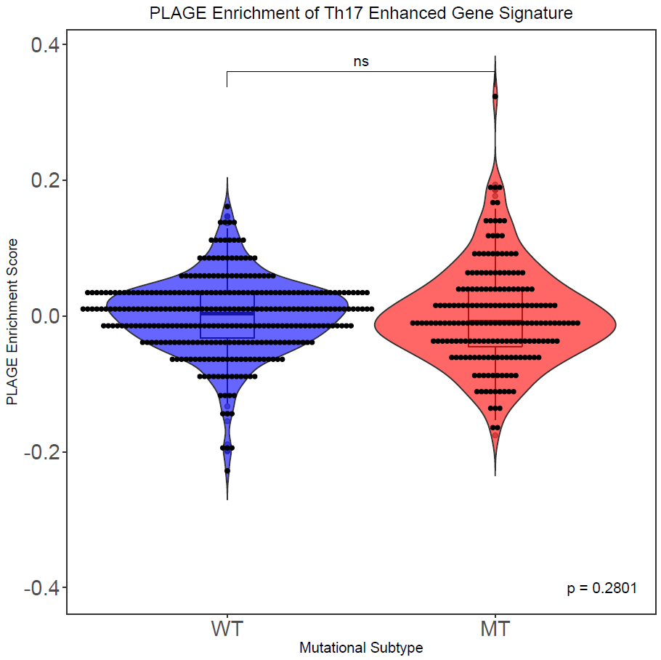
PLAGE – Th17 Standard & Enhanced

Slide 8
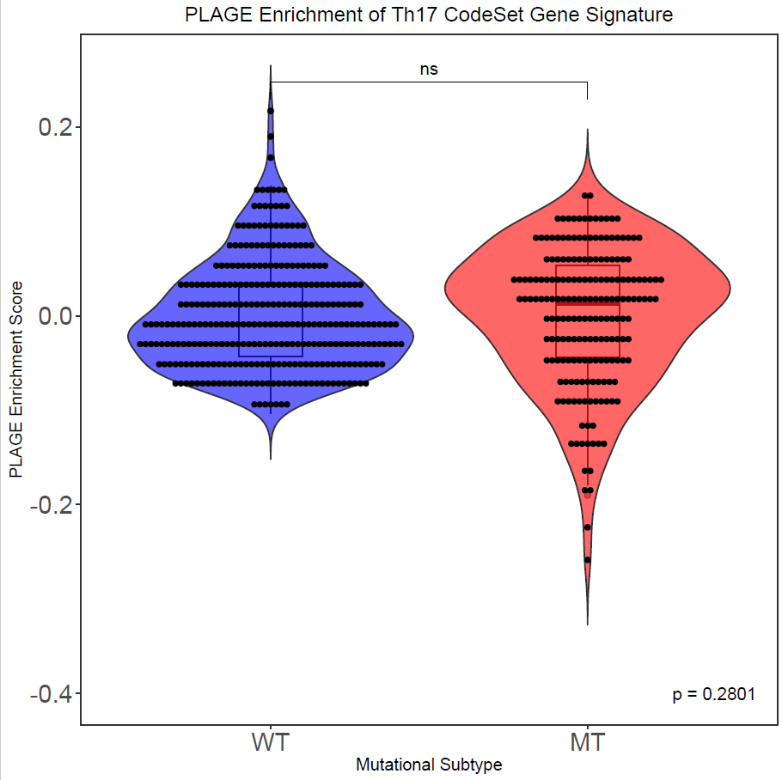
PLAGE – Th17 CodeSet

Slide 9
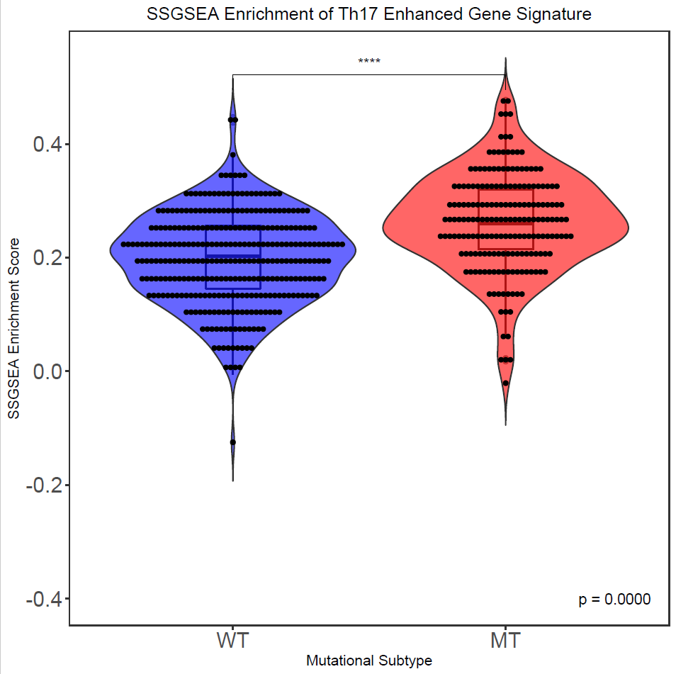
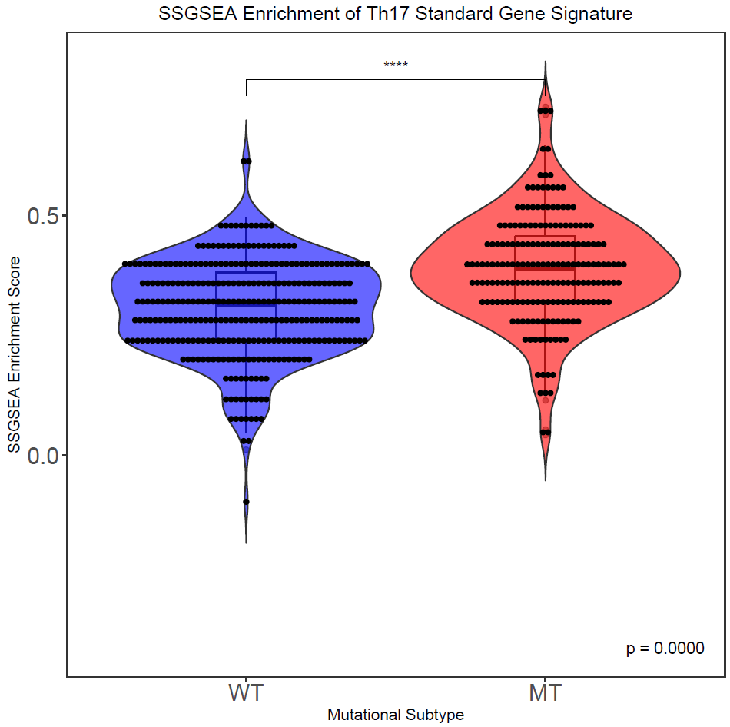
SSGSEA – Th17 Standard & Enhanced

Slide 10
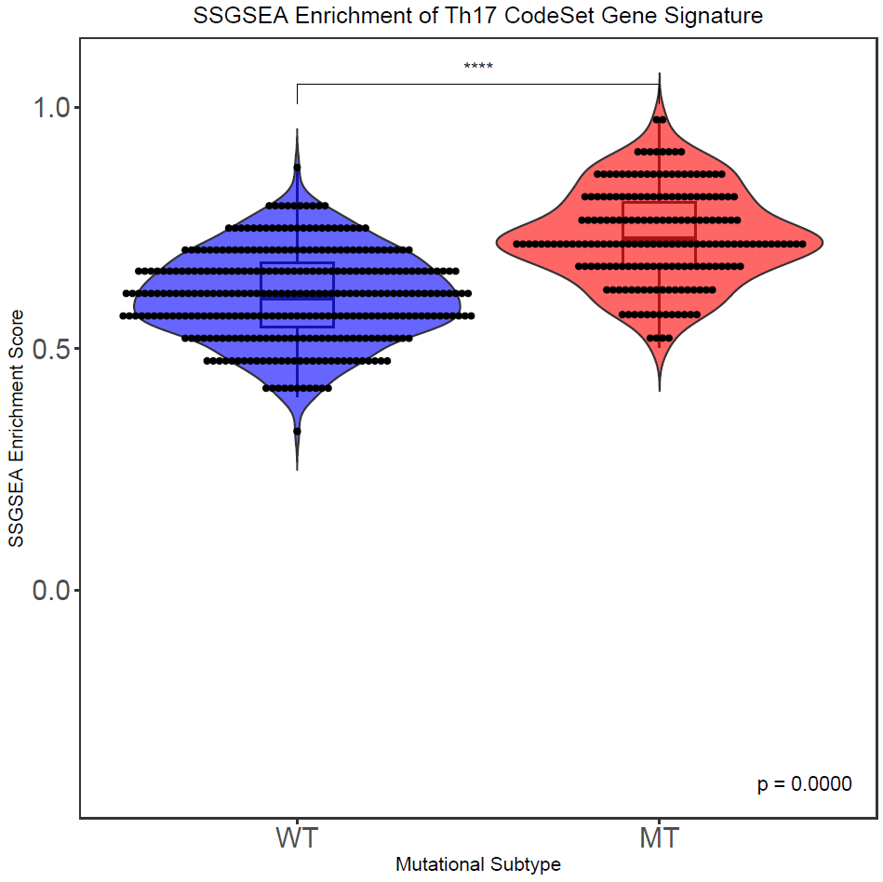
SSGSEA– Th17 CodeSet

Slide 11
Method 2 Post-GSEA Sorting

Slide 12
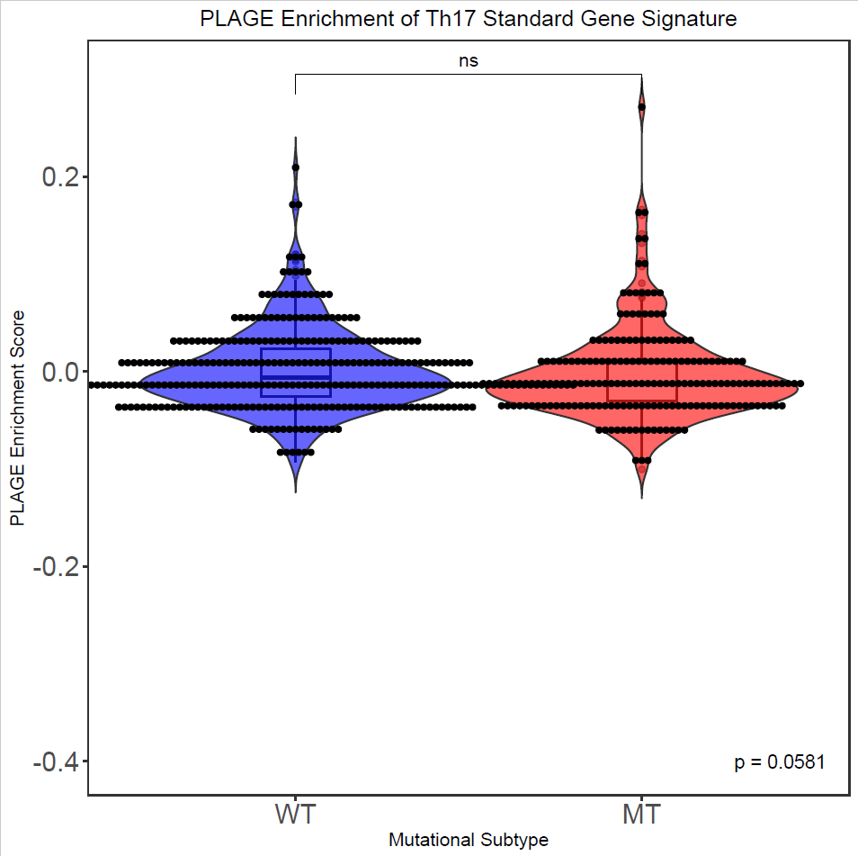
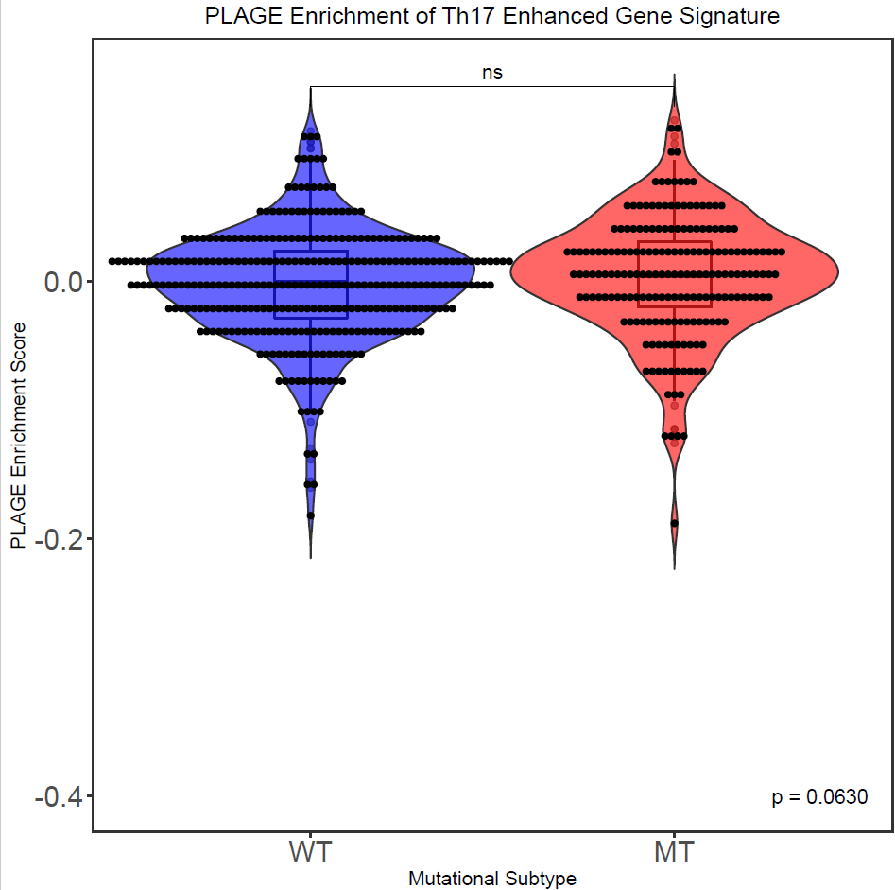
PLAGE – Th17 Standard & Enhanced
WT Median:
-0.006359348
MT Median:
-0.01244489
WT Median:
-0.0007858134
MT Median:
0.005094672

Slide 13
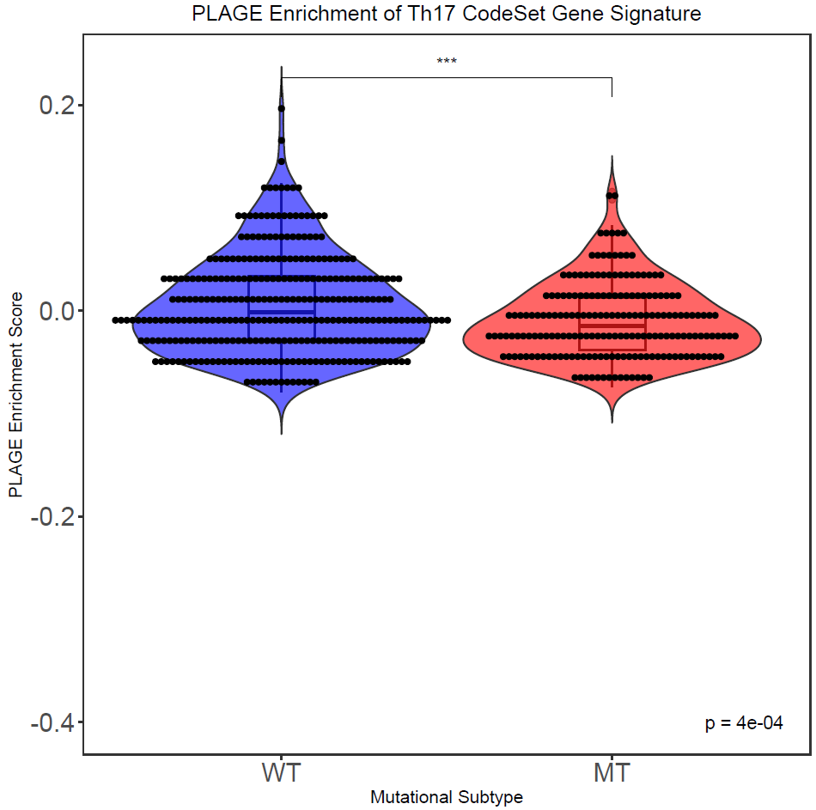
PLAGE – Th17 CodeSet
WT Median:
-0.001331978
MT Median:
-0.01481866

Slide 14
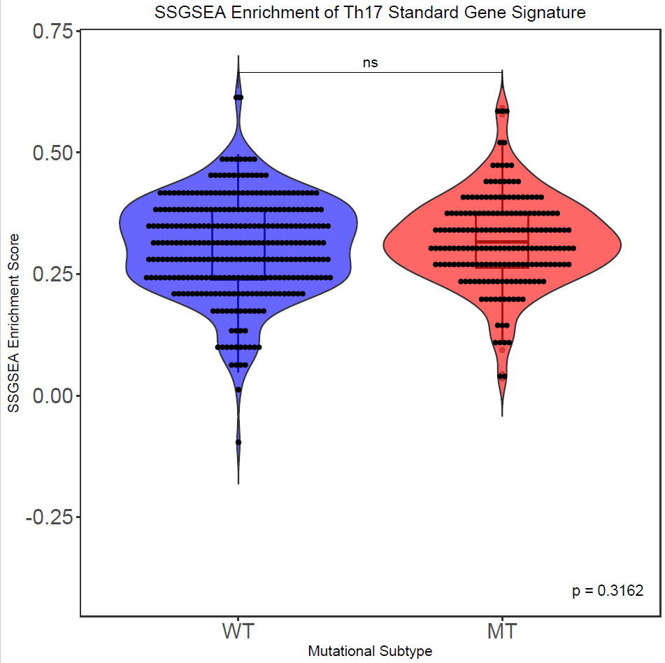
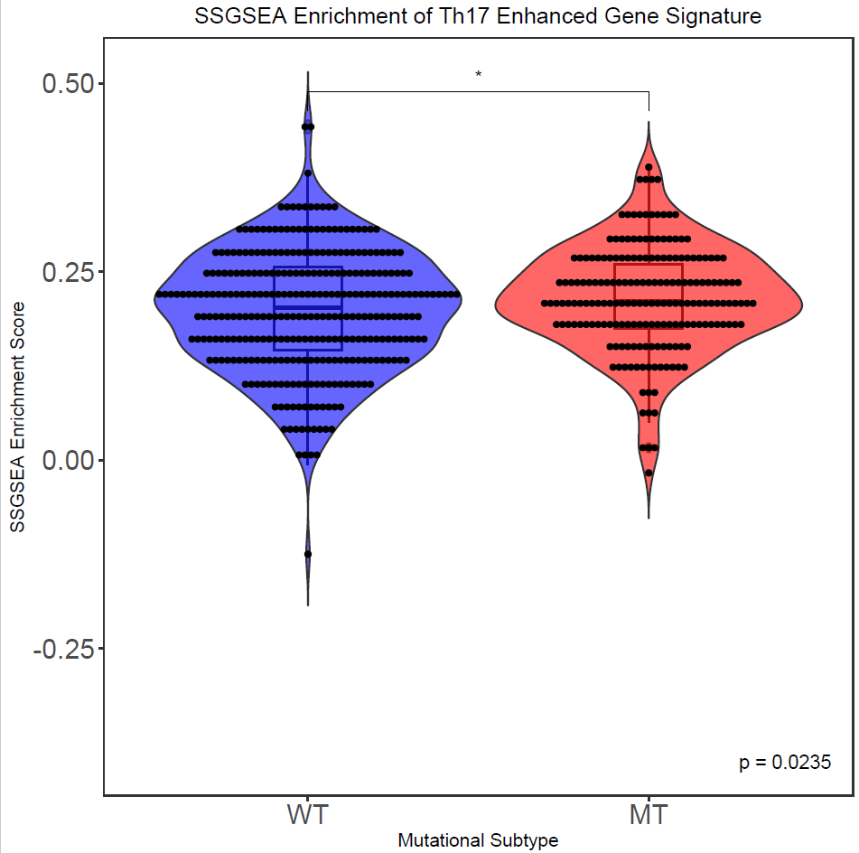
SSGSEA – Th17 Standard & Enhanced
WT Median:
0.3140125
MT Median:
0.3168245
WT Median:
0.2024287
MT Median:
0.2112822

Slide 15
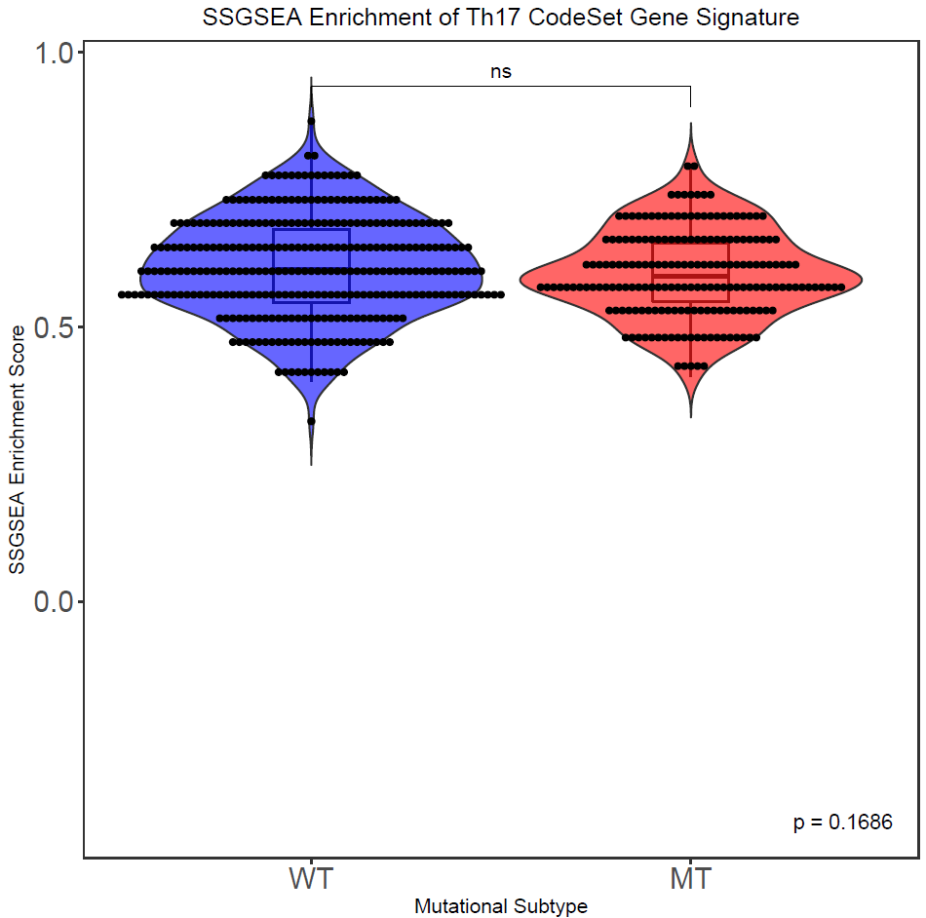
SSGSEA– Th17 CodeSet
WT Median:
0.6053438
MT Median:
0.591842

Slide 16
Analysis Thoughts
Pre-GSEA sorting yields significant results with SSGSEA
Makes sense with the method vs PLAGE and GSVA methods.
Post-GSEA sorting yields sig results with SSGSEA and PLAGE
Doesn’t fit a Th17 story
Am more inclined to believe these
CodeSet signature may not be as Th17-specific with 418 genes?
SSGSEA results from pre-GSEA fit the Th17 story, less strongly fit it in pos-GSEA
The PLAGE post-GSEA results go against the Th17 story with the CodeSet genes
Not entirely sure what to think, not a stinkingly obvious Th17 bias.

